Slide 1
Lending club credit risk predictor
Varun arora

Slide 2

agenda
Objective
Understanding the data
Variable interactions
Proposed model & Selection criteria
Model results
Choosing optimal threshold
Other experiments performed

Slide 3
Objective
The purpose is to develop an XGBoost model to predict the likelihood of a customer’s default on a credit loan.
Training data used is from year 2015 and tested on out-of-time data from year 2016, each containing 20k records.
Target variable (which we want to predict):
Outcome = 1 for loans that are Charged Off (the lender gave up on collecting) or Late (31-120 days) (overdue, high risk of default).
Outcome = 0 for all other statuses (e.g., Fully Paid, Current, In Grace Period, etc.)
The transformation (from loan_status to Outcome) is done to simply distinguish between good vs bad loans

Slide 4
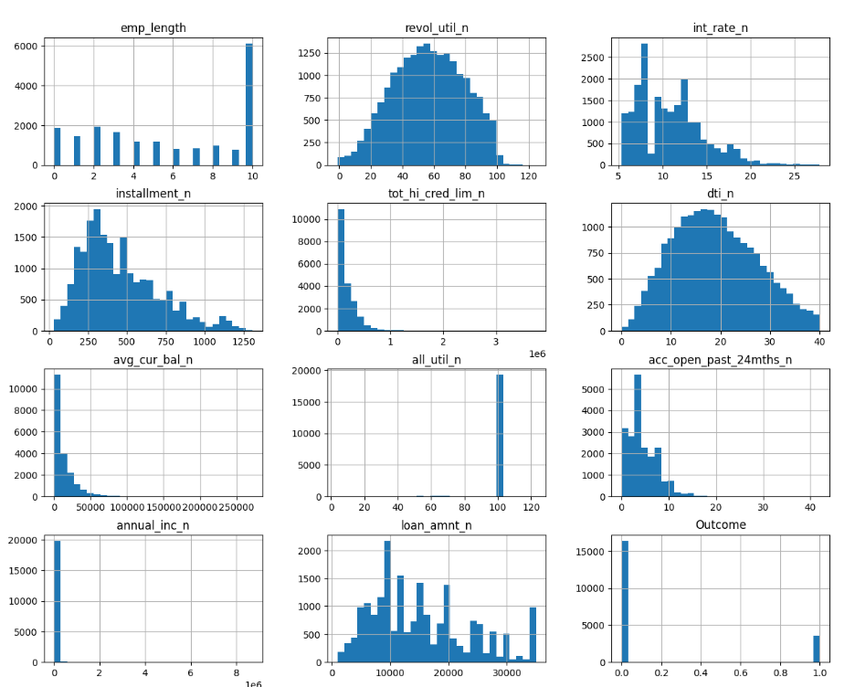
Distribution of Numeric variables
all_util_n - >95% of records have value 100
Outcome: 82% (good), 18% (bad)-unbalanced data
tot_hi_cred_lim_n and avg_cur_bal_n are left skewed
67% of customers have annual income <=50k
emp_length is an ordinal variable

Slide 5
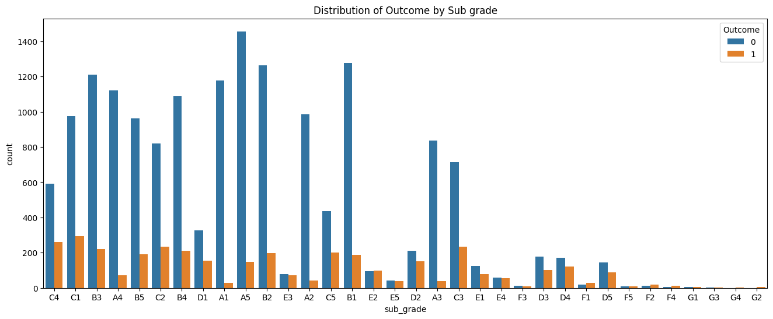
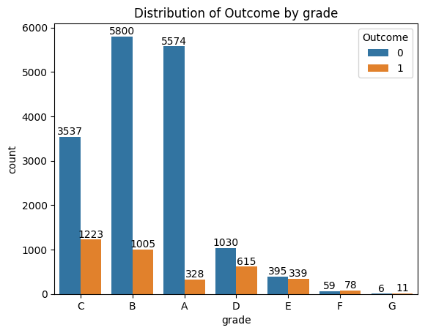
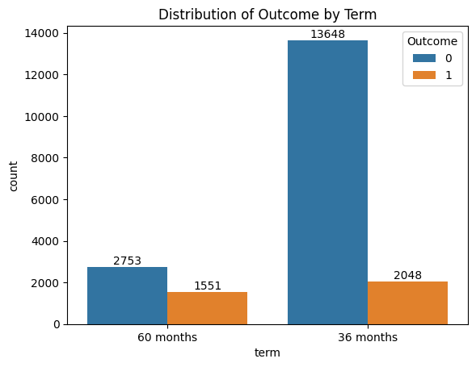
Counts of categorical variables by ‘Outcome’
As the grade and sub_grade deteriorate (from A to F), proportion of bad loan increases
36-month term loans has 13% bad where as 60-month term loans contain 36% of bad loans

Slide 6

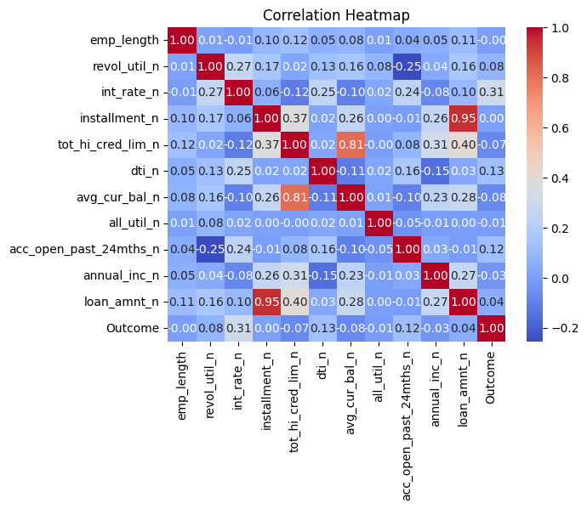
Relation b/w numeric variables
Very high +correlation b/w Loan amount & Installment (0.95)
High +correlation b/w Total high credit limit & Average current balance (0.81)
Moderate +correlation b/w Total high credit limit & Loan amount (0.40)
Relation b/w categorical variables
Cramer’s V value 1 means complete association b/w Grade and Sub grade
Notes:
https://en.wikipedia.org/wiki/Cram%C3%A9r%27s_V

Slide 7
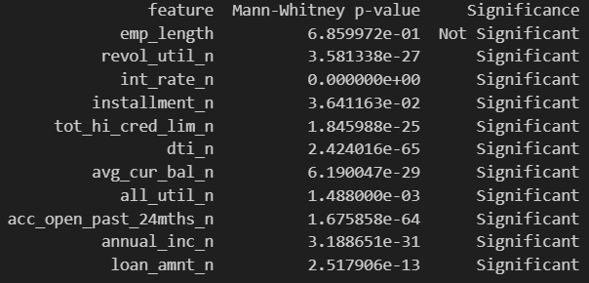
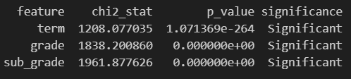
Significance test (Numeric): ‘good’ vs ‘bad’
Non-parametric Mann-Whitney U test was performed (for each numeric variable) to test the null-hypothesis that the two populations (good and bad) are non-distinguishable
Except for emp_length (which is an ordinal, not continuous var), the H0 can be rejected.
For categorical features, Chi2-test was performed to test the significance of association (relationship) between categorical variables and Outcome.
All have a signification association.
Significance test (Outcome vs Categorical )

Slide 8
Proposed model
Algorithm: XGB Classifier
Preprocessing: Label encoding for categorical features, scaling of numerical features not required for tree-based models
Cross-validation: 5-fold CV with 3 repeats using random seeds
Hyperparameters:
tree depth (max depth of each tree): 3
subsample (fraction of training data randomly selected for each boosting round): 0.6
learning rate (controls the step size): 0.1
number of estimators (# of boosting rounds): 100
minimum child weight (min weight of records required for split): 3
column subsampling (fractions of features randomly selected for each tree): 1
gamma (min loss reduction required for a split): 0.1
Best model is selected based on performance (Gini score) and stability (Gini std deviation) across 15 models

Slide 9
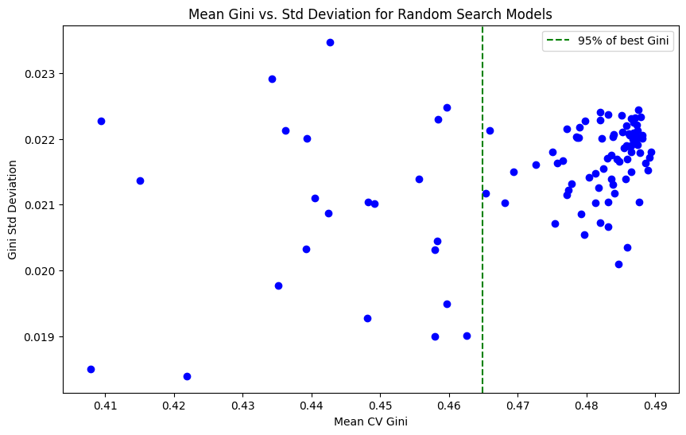
Methodology for best model selection
Select best model by balancing performance (mean Gini) with stability (std dev of Gini) : get all the top 5% gini scores and select the one with minimum standard deviation ensuring performance and generalization.
Mean Gini Score (training data): 0.485
Std Dev of Gini (training data): 0.020
Gini Score (OOT data): 0.405

Slide 10
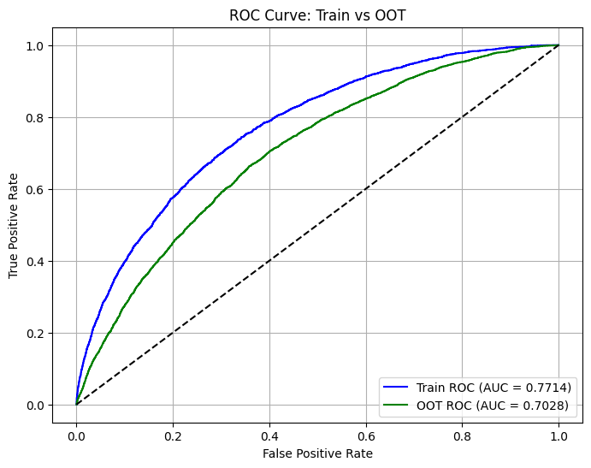
ROC Curve
The gap in the training AUC and OOT ROC (0.068) suggests overfitting which can be further worked upon by:
Feature Engineering
Fine tuning regularization parameters (L1, L2, early stopping, etc.)

Slide 11
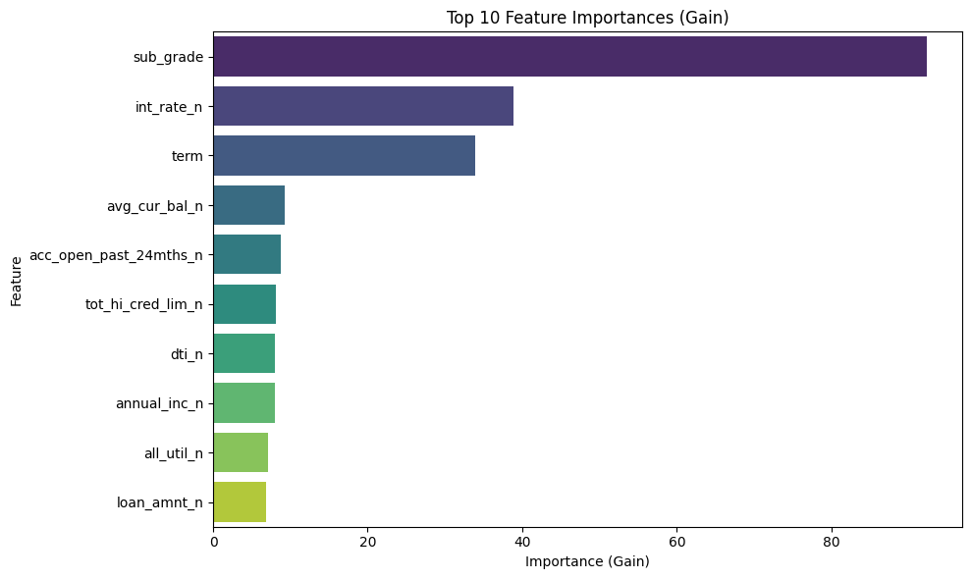
Feature importance
Sub grade, interest rate and term are the most important features in terms of reducing the prediction error and helped the most in splitting the data at key decision nodes.

Slide 12
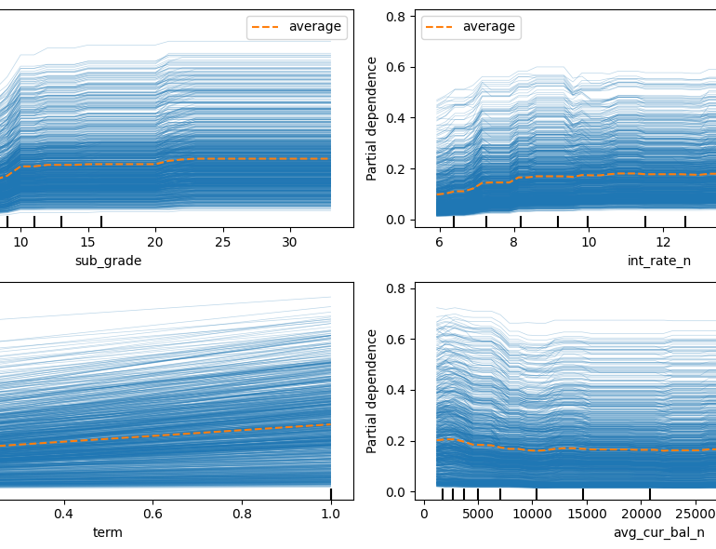
PDP and ice plots (top 4 features)
sub_grade: As the sub grade increases (deteriorates), the likelihood of credit default increases up to a certain point, then stabilizes. There is sharp increase a couple of times in between which probably indicates grade boundaries.
int_rate: With an increase in int_rate, there is a gradual and continuous increase in the default probability. Data is evenly distributed as observed by the rug ticks.
term: It has a constant slope which means a constant increase in default probability with term. We observed the same during univariate analysis (from 13% to 36% increase in bad loan from 36 to 60 months).
avg_curr_bal_n: default decreases initially indicating a slight negative relation and the stabilizes.

Slide 13
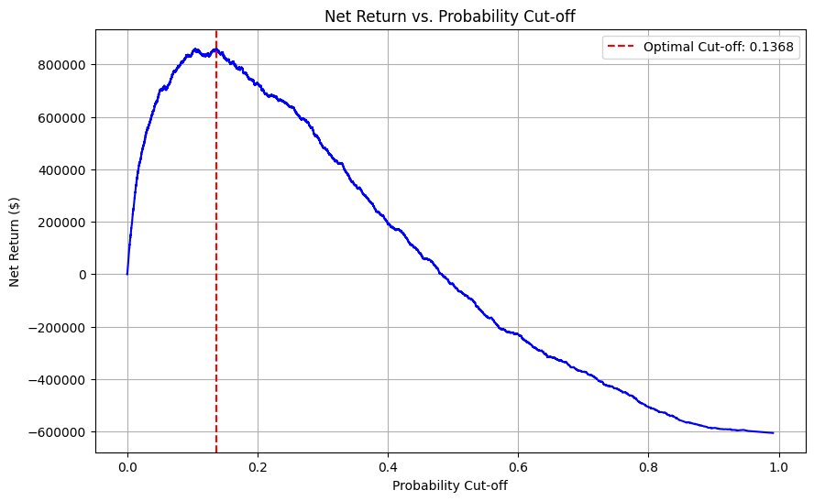
Optimal model cut-off
No cost for a predicted positive case
Return of a true negative case = $300
Cost of a false negative case is $1,000
Net Profit = (TN * 300)-(FN * 1000)
Optimal Threshold: 0.1368
Maximum Net Return: $861,600.00
Please note that there is opportunity loss with False positives which we haven't considered

Slide 14
Feature Engineering(experiment 2 & experiment 3)
Feature engineering in experiment2:
1) Map emp_length to high level categories
2) loan_amnt_installment_n = loan_amnt_n/installment_n (highly correlated)
3) tot_hi_cred_lim_avg_cur_bal_n = tot_hi_cred_lim_n/avg_cur_bal_n (highly correlated)
4) drop all_util_n as >19k out of 20k records has value 100
Feature engineering in experiment3:
1) Impute missing values in emp_length with KNN
2) Categorize all_util_n in 2 buckets: lt100 & ge100
3) Drop installment_n due to very high correlation with loan_amnt_n
4) log transformation of annual_inc_n
5) Drop grade due to Cramer's values of 1 with sub_grade
6) tot_hi_cred_lim_avg_cur_bal_n = tot_hi_cred_lim_n/avg_cur_bal_n (highly correlated)
Despite feature engineering in experiments 2 and 3, the metrics did not improve and hence proposed the base model

Slide 15

Thank you
Varun arora| linkvarun@gmail.com | +61-420768193

